Slide 1
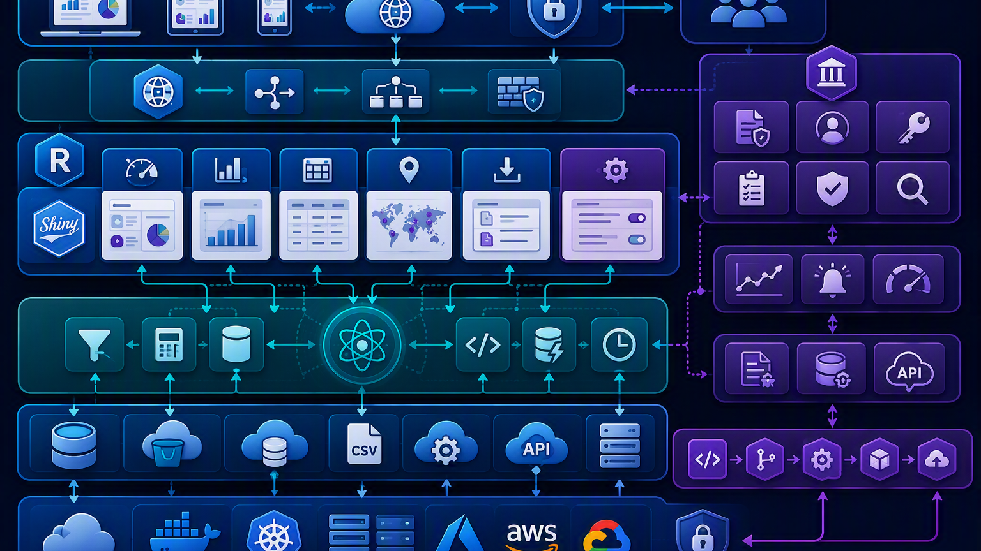
R Shiny Dashboard Training
Diagram-first slide deck
Less text. More architecture, workflows, and dashboard blueprints.
Disclaimer: The data or the work is for presentation purposes only and does not involve any real patient data or violate any codes of confidentiality. The opinions expressed in this presentation and on the following slides are solely those of the presenter and not from the organization I belong to. It does not guarantee the accuracy or reliability of the information presented herein.
Notes:
Generated from Combined_R_Shiny_Training_Manual.html.
[Sources]
Source file: Combined_R_Shiny_Training_Manual.html.
Visual on this slide was generated with Microsoft Copilot.

Slide 2
Manual-to-slide transformation
The combined manual is converted into visual teaching blocks rather than text-heavy slides.
Combined
HTML Manual
Extract
Concepts
Convert to
Diagrams
Add
Examples
Teach
01
Architecture
02
UI/Server
03
Reactive flow
04
Dynamic UI
05
Conditional panels
06
Upload/download
07
DT & Plotly
08
Modular design
Notes:
Generated from Combined_R_Shiny_Training_Manual.html.
[Sources]
Manual contains modules on Shiny architecture, UI components, first Shiny app, layouts, hands-on exercises, reactive programming, dynamic UI, conditional panels, tabs/navigation, upload/download, validation, notifications, DT tables, interactive plots, mini project, and modular structure.

Slide 3
Visual learning roadmap
A single visual path that reflects the manual sections.
1
2
3
4
5
6
7
Intro
Basics
Build
Practice
Intermediate
Capstone
Advanced
Shiny architecture
Inputs and outputs
First app and layouts
Hands-on exercises
Reactivity and dynamic UI
Study dashboard
Modules and enterprise
Instructor view: each module becomes a diagram slide, followed by a short runnable example or lab prompt.
Notes:
Generated from Combined_R_Shiny_Training_Manual.html.
[Sources]
Source manual table of contents lists the major sections used in this roadmap.

Slide 4
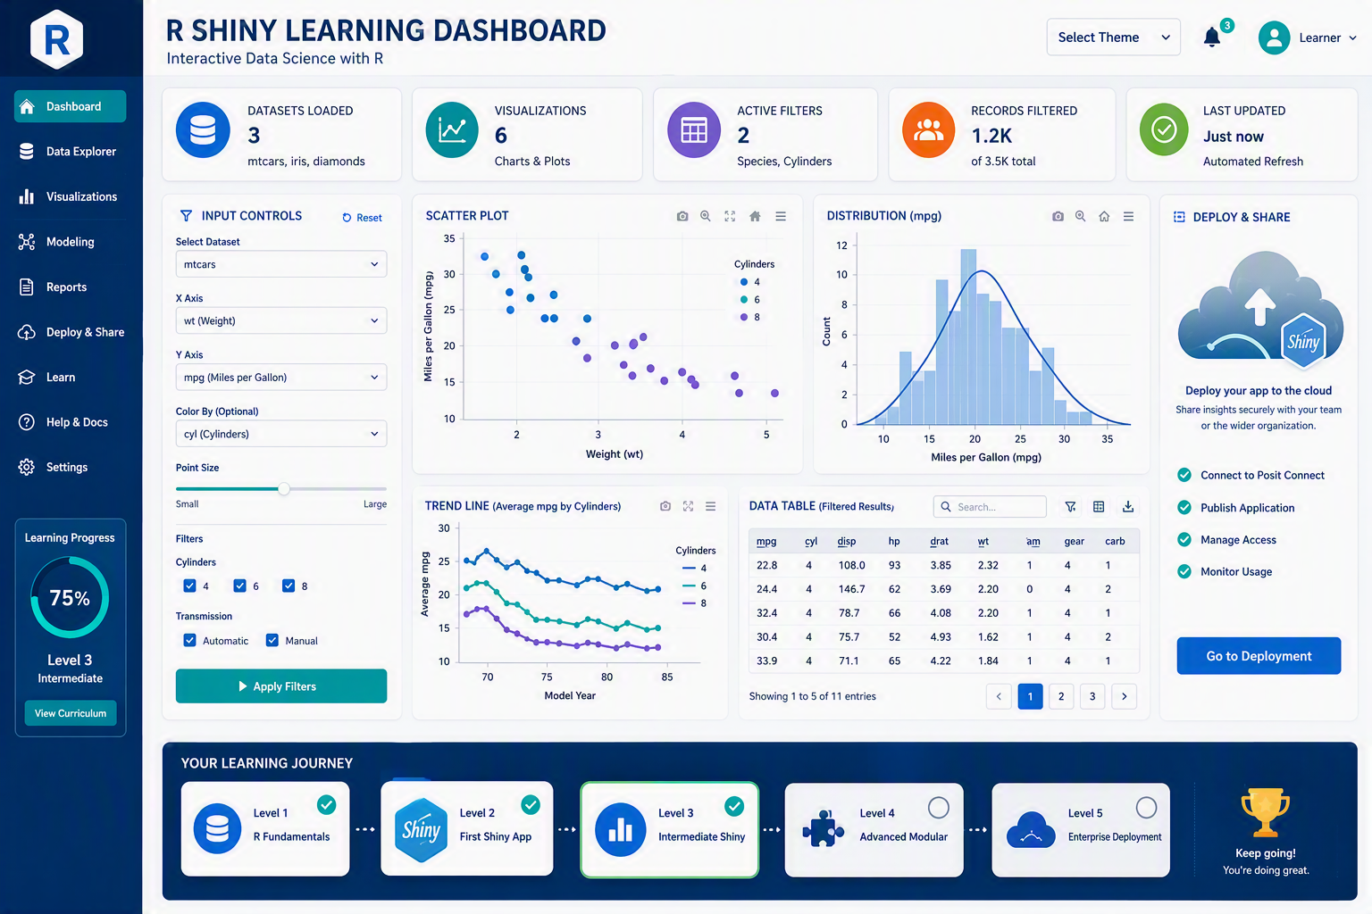

Slide 5
Shiny architecture diagram
Manual concept: Shiny applications combine User Interface, Server Logic, and Reactive Engine.
User Interface
UI
User
Action
Results
Plots • Tables • Text
Reactive
Engine
Server
Logic
input changes drive updates
Notes:
Generated from Combined_R_Shiny_Training_Manual.html.
[Sources]
The manual states a typical Shiny application consists of User Interface, Server Logic, and Reactive Engine, with results returned as plots, tables, and text.
Diagram text is based on the Architecture Diagram section.

Slide 6
Input controls as a visual palette
Manual concept: user inputs drive interactive applications.
textInput()
Text entry
selectInput()
Dropdown choice
sliderInput()
Numeric range
checkboxInput()
True/false
dateInput()
Date selector
fileInput()
Upload files
Design principle: show only the input controls that support the learner exercise.
Notes:
Generated from Combined_R_Shiny_Training_Manual.html.
[Sources]
The manual lists common input components including textInput(), selectInput(), sliderInput(), checkboxInput(), dateInput(), and fileInput().

Slide 7
Output components as a dashboard palette
Manual concept: server logic renders tables, plots, text, interactive tables, and downloads.
plotOutput()
Graphs
tableOutput()
Tables
DT::dataTableOutput()
Interactive tables
textOutput()
Text
downloadButton()
Downloads
Server
Logic
Render
Function
Visible
Output
Notes:
Generated from Combined_R_Shiny_Training_Manual.html.
[Sources]
The manual lists common output components including plotOutput(), tableOutput(), DT::dataTableOutput(), textOutput(), and downloadButton().

Slide 8
First Shiny app lifecycle
Manual concept: every app is built from UI, Server, and shinyApp().
1
2
3
4
5
Load package
library(shiny)
Define UI
fluidPage()
Define Server
function(input, output)
Bind outputs
renderText/renderPlot
Run app
shinyApp(ui, server)
Notes:
Generated from Combined_R_Shiny_Training_Manual.html.
[Sources]
The manual describes the basic structure of a Shiny app: library(shiny), UI, server, and shinyApp(ui, server).

Slide 9
Layouts: fluidPage() vs sidebarLayout()
Manual concept: layouts organize inputs and outputs for usability.
fluidPage()
sidebarLayout()
Title
Filters
Plot
Input
Slider
Table
Text
Checkbox
sidebarPanel()
mainPanel()
Summary
Plot
Table
Notes:
Generated from Combined_R_Shiny_Training_Manual.html.
[Sources]
The manual compares fluidPage() and sidebarLayout(): fluidPage creates responsive page layout, while sidebarLayout creates a sidebar and main output area.

Slide 10
Reactive functions decision map
Manual concept: choose a reactive tool based on whether it returns a value and what triggers it.
Yes
reactive()
No
observe()
Need a
value?
Yes, on event
eventReactive()
No, on event
observeEvent()
reactive(): Filtering, calculations, reusable logic
observe(): Notifications, logging, control updates
observeEvent(): Run, refresh, submit actions
eventReactive(): On-demand models or reports
Notes:
Generated from Combined_R_Shiny_Training_Manual.html.
[Sources]
The manual compares reactive(), observe(), observeEvent(), and eventReactive() by return value, trigger, and typical usage.

Slide 11
Reactive dependency graph
Manual concept: reactive dependencies define how information flows between inputs, reactive expressions, and outputs.
input$species
Table
filtered_data()
Record Count
input$pointsize
Scatter Plot
One shared reactive expression can feed multiple outputs, reducing repeated filtering logic.
Notes:
Generated from Combined_R_Shiny_Training_Manual.html.
[Sources]
The manual shows dependency graphs where input$species feeds filtered_data(), which then feeds Table and Record Count, and another graph where input$species and input$pointsize affect output$scatter.

Slide 12
Dynamic UI flow
Manual concept: uiOutput() and renderUI() create controls based on user selections.
Example: Oncology -> survival/response endpoints | Diabetes -> HbA1c/glucose endpoints | Cardiology -> BP/heart-rate endpoints
Select
Study Type
renderUI()
Endpoint
Dropdown
Reactive
Filter
Chart
Table
Notes:
Generated from Combined_R_Shiny_Training_Manual.html.
[Sources]
The manual describes Dynamic UI using uiOutput() and renderUI(), including a clinical example where endpoint choices depend on study type: Oncology, Diabetes, and Cardiology.

Slide 13
Conditional panels workflow
Manual concept: conditionalPanel() shows or hides existing controls based on user choices.
Study
Selection
conditionalPanel()
Oncology
Overall Survival
Tumor Response
Diabetes
HbA1c
Fasting Glucose
Cardiology
Blood Pressure
Heart Rate
Reactive Data Filter
Chart + Table update
Notes:
Generated from Combined_R_Shiny_Training_Manual.html.
[Sources]
The manual shows a Conditional Panel Workflow with Study Selection leading to conditionalPanel(), then Oncology, Diabetes, and Cardiology endpoint filters, then Reactive Data Filter, Chart, and Table.

Slide 14
Workflow trio: tabs, upload/download, validation
Manual concept: production-ready apps organize content, accept files, export results, and validate inputs.
Tabs
Clinical Dashboard
Summary Tab
Data Tab
Charts Tab
Upload / Download
Upload CSV
Read Data
Display Table
Download CSV
Validation
User Input
Validation Check
Valid -> Result
Invalid -> Message
Notes:
Generated from Combined_R_Shiny_Training_Manual.html.
[Sources]
The manual includes separate workflows for Tabs, Upload/Download, and Error Handling/Validation.

Slide 15
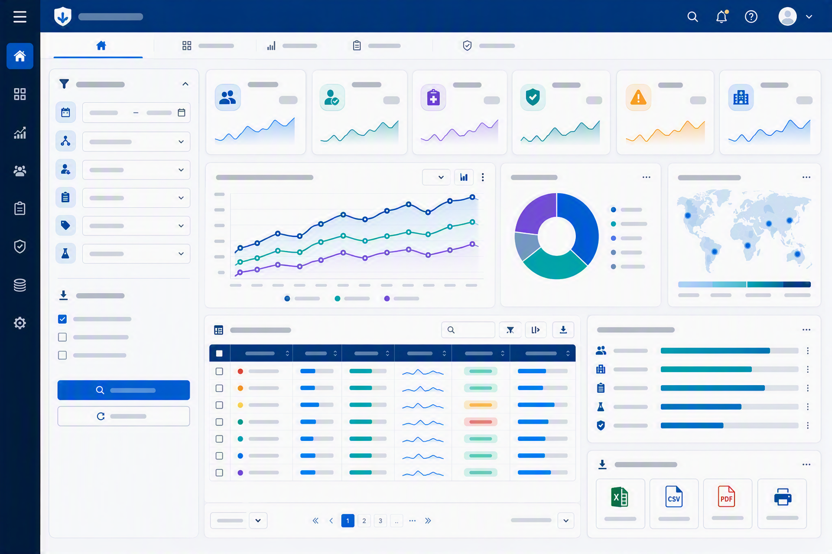
Interactive experience layer
Manual concept: notifications, DT tables, and Plotly improve usability and exploration.
showNotification()
message / warning / error
User Action
button / upload / filter
DT Table
search • sort • filter
Dashboard
Feedback Loop
Plotly
hover • zoom • pan
Notes:
Generated from Combined_R_Shiny_Training_Manual.html.
[Sources]
The manual includes notification workflow, DT workflow, and Plotly workflow. It states users can search/sort/filter DT tables and hover/zoom/pan interactive Plotly charts.
Visual on this slide was generated with Microsoft Copilot.

Slide 16
Mini project: study-level dashboard blueprint
Manual concept: combine enrollment metrics, trend analysis, subgroup filtering, DT table, notifications, validation, and download.
Filters
Enrollment
Metrics
Trend
Analysis
Interactive
DT Table
Study
Subgroup
Refresh
Download
Validation
Messages
User
Notifications
Notes:
Generated from Combined_R_Shiny_Training_Manual.html.
[Sources]
The manual mini project requires enrollment metrics, trend analysis, subgroup filtering, interactive table, download reports, user notifications, and validation/error handling.
Visual on this slide was generated with Microsoft Copilot.

Slide 17
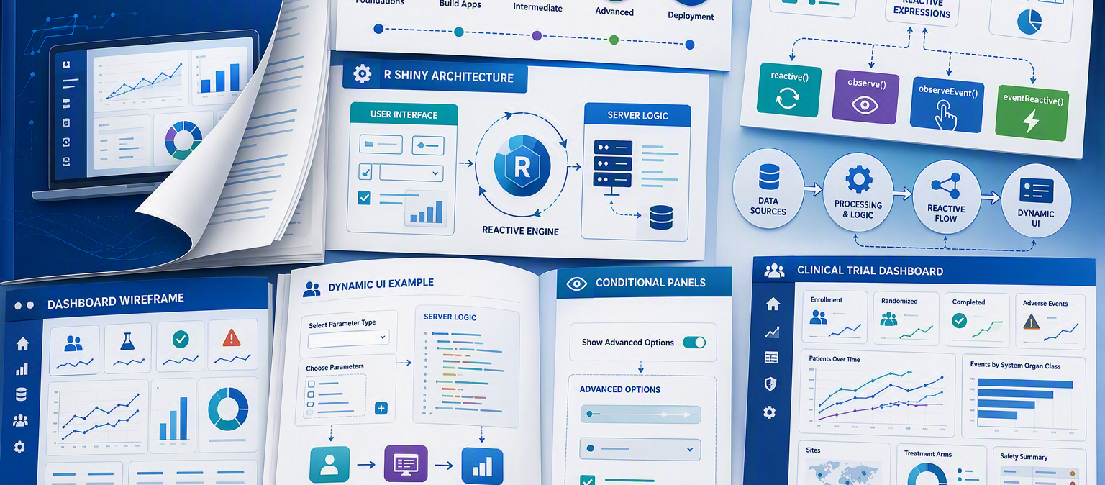
Level 4: modular architecture
Manual concept: split a large Shiny app into independent UI and server modules.
Notes:
Generated from Combined_R_Shiny_Training_Manual.html.
[Sources]
The manual describes modular architecture using Filter, Metrics, Trend Plot, Interactive Table, and Download modules connected through shared reactive data.
Visual on this slide was generated with Microsoft Copilot.

Slide 18
Level 4: modular architecture
Manual concept: split a large Shiny app into independent UI and server modules.
Filter
Module
Metrics
Module
Trend Plot
Module
Table
Module
Download
Module
Shared Reactive Dataset
Notes:
Generated from Combined_R_Shiny_Training_Manual.html.
[Sources]
The manual describes modular architecture using Filter, Metrics, Trend Plot, Interactive Table, and Download modules connected through shared reactive data.
Visual on this slide was generated with Microsoft Copilot.

Slide 19
Project structure diagram
Manual concept: a production-style app separates modules, data, and static assets.
Project
app.R
modules/
data/
www/
filters.R
study_data.csv
styles.css
metrics.R
trend_plot.R
study_table.R
download_report.R
Notes:
Generated from Combined_R_Shiny_Training_Manual.html.
[Sources]
The manual project structure lists app.R, modules/ with filters.R, metrics.R, trend_plot.R, study_table.R, download_report.R, data/study_data.csv, and www/styles.css.

Slide 20
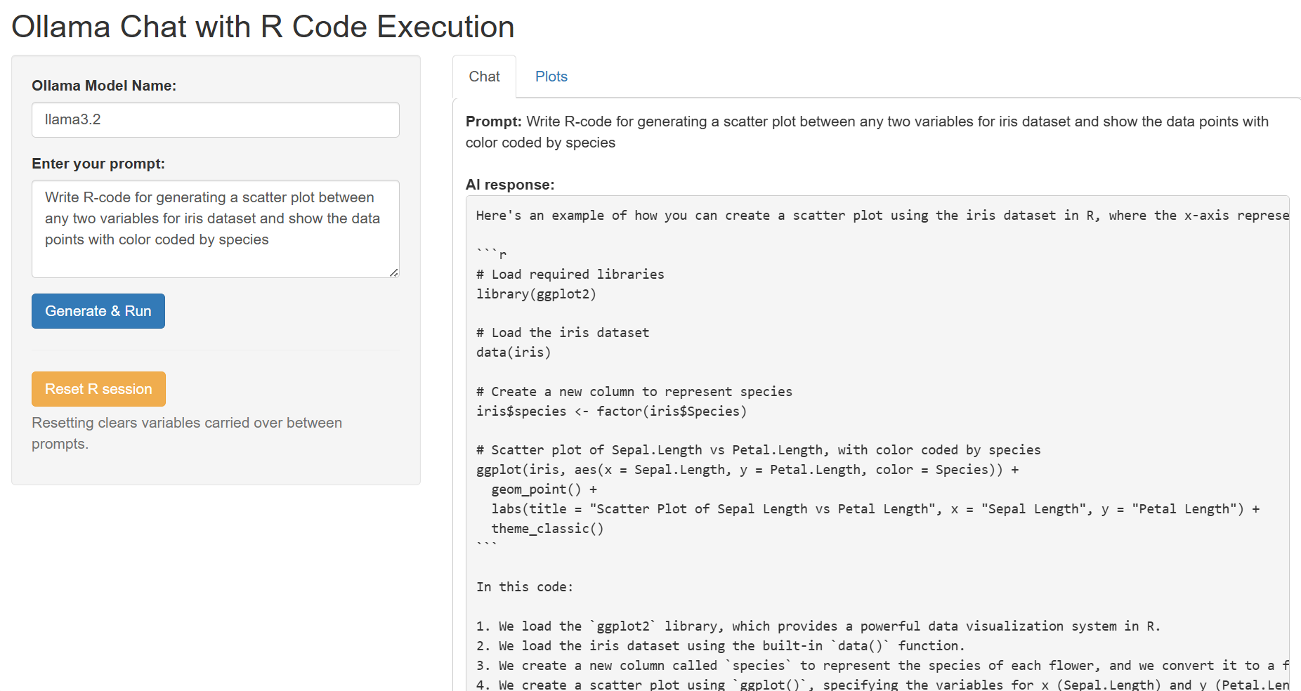

Slide 21
